Slide 1

Classification of YouTube Videos
Department Of Computer Science and Engineering
(Supervisor: Dr Deepti Gupta)

Slide 2
TEAM
Name of Member | Roll Number | Role
Akash Kandpal | 1513310027 | Backend Part
Sivasish Koch | 1513310214 | Javascript Scripts
Saif Ali | 1513321165 | Manual Testing
Rahul Bilra | 1513310161 | Scrapers

Slide 3
INTRODUCTION
The total number of people who use YouTube – 1,300,000,000.
300 hours of video are uploaded to YouTube every minute.
Almost 5bn videos are watched on YouTube every single day.
YouTube gets over 30 mn visitors per day.
Would it not be better if we(mostly students) could get those videos tagged which could help us in avoiding un-educative videos?

Slide 4
LITERATURE SURVEY
Software present currently are limited in scope and they don’t deal directly with classification of YouTube videos.
Currently the systems mainly focuses on building recommendation systems for Youtube and likewise video sites.
Youtube itself is working on classification of videos automatically.

Slide 5
PROBLEM STATEMENT
Indian Youth users on YouTube gets distracted by much of the non-educative content on YouTube and watching those videos results in wastage of our time. This ​reduces​​ our productivity​​ and also makes us ​mentally tired​​ so to stop this we require some strategy to tag those videos as non-educative ones.

Slide 6
PROPOSED METHODOLOGY
We started with the generation of wordlist.txt file which contains the educative words from manually selected YouTube channels. As, there was a limit on the per day usage of YouTube API hits to 10k, so we created a scraper using Python and utilised it to get titles from these videos.
Further we removed stop words and cleaned the text using NLTK library. Then we used gensim for increasing the coverage of those words by forming tree structure and this tree structure covered many synonyms of already present words.

Slide 7
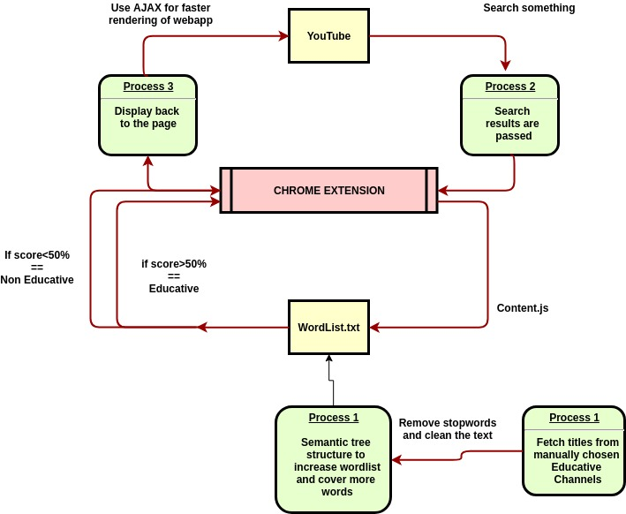
DFD DIAGRAM

Slide 8
PROPOSED METHODOLOGY
Here, AJAX script is used for the faster rendering (without page reloading) of YouTube.
Also, simple algorithm is used which matches the words in the title after removing the stopwords with the already generated wordlist.txt.
At last it renders the calculated value back to the server and this displays whether a particular video is educative or not.

Slide 9
FEASIBILITY STUDY
The project utilises a simple chrome extension which means that no extra hardware required. Also, there is no scalability issue as it can be downloaded from the chrome store and can be installed easily.
The product is made for free use, not for monetary gains so it’s freely available on our github wherein it can be downloaded in zipped format and extracted , here is the installation video. It is not uploaded on Chrome Web Store.

Slide 10
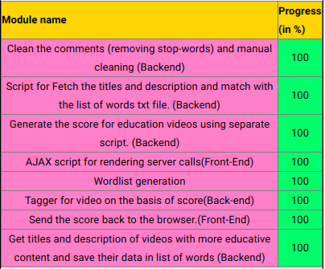
MODULES

Slide 11
HARDWARE REQUIREMENTS
Developer End Requirements
OS: Any Linux variant
Hard Drive: 500GB
RAM: 2 GB
User End Requirements
OS:Window 7
Hard Drive: 100GB
RAM: 256 MB

Slide 12
SOFTWARE REQUIREMENTS
Developer End Requirements
Gensim : https://radimrehurek.com/gensim/
NLTK : https://www.nltk.org/
Chrome Extension
JavaScript
Plotly : For visualising graphs.
YouTube API
User End Requirements
Chrome Web Browser

Slide 13
LIVE DEMO
Installation Video
Demo Video

Slide 14
CONCLUSION
The project’s aim was to make it easier for tagging the videos for educative content and thus enhancing the user-experience of the Youtube users which is working with a reasonable accuracy.
So, this is a small effort from our side to improve the quality of videos and tag videos on Youtube by providing them scores, lot of advancements will be seen in this area in the near future.

Slide 15
REFERENCES
1. Bentivogli, L., Forner, P., Magnini, B., Pianta, E.: Revising WordNet Domains Hierarchy: Semantics, Coverage, and Balancing. In Proceedings of COLING Workshop on Multilingual Linguistic Resources, Geneva Switzerland (2004) 101-108
2. Yi, H.R., Deepu, R., Chia, L.T.: Semantic Video Indexing and Summarization Using Subtitles. Lecture Notes on Computer Science, Vol. 3331. Springer-Verlag Berlin Heidelberg New York (2004) 634-641
3. Declerck, T., Kuper, J., Saggion, H., Samiotou, A., Wittenburg, P., Contreras, J.: Contribution of NLP to the Content Indexing of Multimedia Documents. Lecture Notes on Computer Science, Vol. 3115. Springer –Verlag Berlin Heidelberg New York (2004) 610- 618

Slide 16
REFERENCES
4. Reidsma, D., Kuper, J., Declerck, T., Saggion, H., Cunningham, H.: Cross document annotation for multimedia retrieval. In EACL Workshop Language Technology and the Semantic Web (NLPXML) Budapest (2003)
5. Hangzai Luo, Jianping Fan, Jing Xiao, Xingquan Zhu, Semantic principal video shot classification via mixture Gaussian. In Proc. of IEEE International Conference on Multimedia & Expo. Vol.1, Baltimore, MD. (2003)
6. Suresh, V., Mohan, K.C., Swamy, K.R., Yegnanarayana, B.: Content-based Video Classification Using Support Vector Machines. In ICONIP-04, Calcutta, India (2004) 726- 731

Slide 17
THANK YOU

